Slide 1
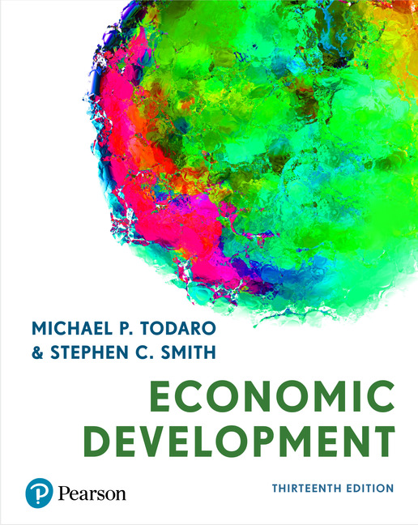
Economic Development
Thirteenth Edition
Chapter 2
Comparative economic development

Slide 2
2.1 Defining the Developing World (note these are updated annually)
The World Bank ranks countries on Gross National Income (GNI) per capita (updated 2022)
Low-Income Countries (LICs) < $1085
Lower-Middle Income Countries (LMCs)
$1085 < GDPpp < $4255 pp
Upper-Middle Income Countries (UMCs)
$4255 < GDPpp < $13205
High-income OECD countries > $13,205
Other high-income countries (non-OECD, eg Qatar)
(See Table 2.1 and Figure 2.1)

Slide 3
2.2 Basic Indicators of Development: Real Income, Health, and Education
Gross National Income (GNI)
Gross Domestic Product (GDP)
PPP method instead of exchange rates as conversion factors (see Table 2.2)
Notes:
GDP is not the only way in evaluating economic development, usually we use GPDpp (per capita), and we have to convert all income to USD, and we also have to consider the purchasing power of income

Slide 4
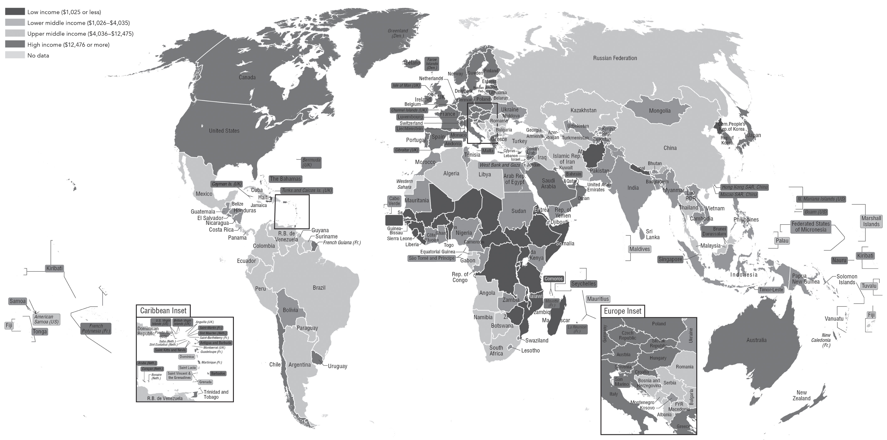
Figure 2.1
Nations of the World, Classified by GNI Per Capita

Slide 5
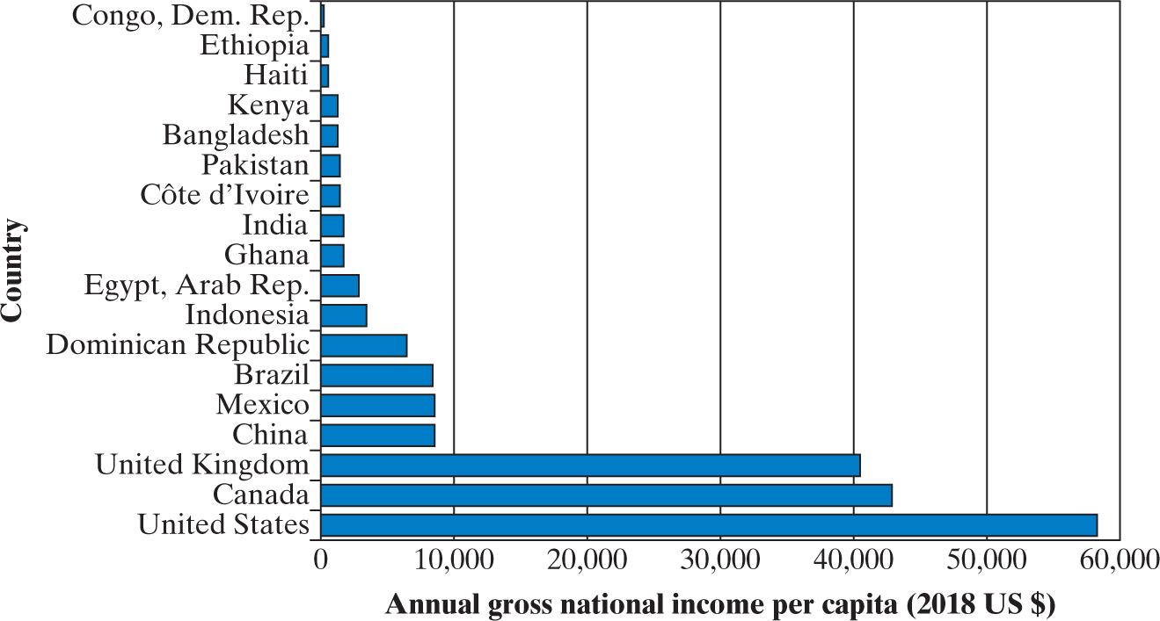
Figure 2.2
Income Comparisons for Selected Countries, 2017
Source: World Development Indicators

Slide 6
In 2017, high-income countries received nearly 2/3 of world income despite having 1/6 of the population

Slide 7
Some Measurement Issues
1) Low-income countries usually have poor-quality stats
2) Methodological issues when doing calculations
Notes:
Low-income countries have poor-quality stats in different fields, so there is no perfect stat, each countries calculate differently.

Slide 8
3) If in agriculture and do not sell (for own use)… not included, therefore production would be undervalued
Including estimates
4) Cost of pollution not deducted
Net economic welfare (NEW):
-attempt to deduct costs of pollution, crime, congestion, etc
Is this a problem only for developing countries?
Notes:
The GDP might be under-estimate if a country is heavily based on agriculture since products are not sold, or the goods are bought with cash so there is not tax. Also, black market might be more activate in developing countries.
Net development = GDP - depreciation

Slide 9
Exchange Rate Problems
5) Exchange rate (ER) issues arise since must convert GDP #s to US$:
a) ERs frequently distorted in developing countries
b) significant part of GDP made up of non-traded goods and services which are NOT traded internationally → makes no sense to talk about the int’l price
c) government intervention in ER determination
Notes:
So, if the current in some countries is weaker to USD, it is not good to the GDP calculation. Even if the actual domestic economic is getting better, it might looks worse. This case is usual in developing countries since their current could be significantly weaker to USD.
Exchange rate moves with imports and exports.

Slide 10

One way of partially adjusting for some of these problems is to use Purchasing Power Parity (PPP) ER—pick a set of prices prevailing in one of the countries and use that set of prices to value the goods and services being compared.
PPP holds when the real exchange rate (RER)
RER = 1
RER = P dom x ER
Pf
Pdom=domestic price, Pf = foreign price
See mathematical problem for example

Slide 11
 | GNI per capita, Atlas method (current US$) | GNI per capita, Atlas method (current US$) | GNI per capita, PPP (current international $) | GNI per capita, PPP (current international $)
Bolivia | 3,530.0 | 3,530.0 | 8,910.0 | 8,910.0
Bangladesh | 1,940.0 | 1,940.0 | 5,190.0 | 5,190.0
Botswana | 7,660.0 | 7,660.0 | 17,110.0 | 17,110.0
Brazil | 9,130.0 | 9,130.0 | 14,850.0 | 14,850.0
Cambodia | 1,480.0 | 1,480.0 | 4,180.0 | 4,180.0
Chile | 15,010.0 | 15,010.0 | 24,140.0 | 24,140.0
China | 10,410.0 | 10,410.0 | 16,740.0 | 16,740.0
Colombia | 6,510.0 | 6,510.0 | 15,150.0 | 15,150.0
Congo, Dem. Rep. | 520.0 | 520.0 | 1,110.0 | 1,110.0
Costa Rica | 11,700.0 | 11,700.0 | 19,250.0 | 19,250.0
Cote d'Ivoire | 2,290.0 | 2,290.0 | 5,290.0 | 5,290.0
Dominican Republic | 8,090.0 | 8,090.0 | 18,280.0 | 18,280.0
Egypt, Arab Rep. | 2,690.0 | 2,690.0 | 11,810.0 | 11,810.0
Ghana | 2,220.0 | 2,220.0 | 5,510.0 | 5,510.0
Guatemala | 4,610.0 | 4,610.0 | 8,850.0 | 8,850.0
Haiti | 790.0 | 790.0 | 1,790.0 | 1,790.0
India | 2,130.0 | 2,130.0 | 6,960.0 | 6,960.0
Indonesia | 4,050.0 | 4,050.0 | 11,930.0 | 11,930.0
Kenya | 1,750.0 | 1,750.0 | 4,420.0 | 4,420.0
Korea, Rep. | 33,720.0 | 33,720.0 | 43,430.0 | 43,430.0
Mexico | 9,430.0 | 9,430.0 | 19,810.0 | 19,810.0
Niger | 560.0 | 560.0 | 1,250.0 | 1,250.0
Nigeria | 2,030.0 | 2,030.0 | 5,170.0 | 5,170.0
Pakistan | 1,530.0 | 1,530.0 | 5,210.0 | 5,210.0
Peru | 6,740.0 | 6,740.0 | 12,760.0 | 12,760.0
Philippines | 3,850.0 | 3,850.0 | 10,200.0 | 10,200.0
Senegal | 1,450.0 | 1,450.0 | 3,440.0 | 3,440.0
Thailand | 7,260.0 | 7,260.0 | 18,520.0 | 18,520.0
Uganda | 780.0 | 780.0 | 2,210.0 | 2,210.0
Vietnam | 2,540.0 | 2,540.0 | 7,750.0 | 7,750.0
Canada | 46,370.0 | 46,370.0 | 50,810.0 | 50,810.0
United Kingdom | 42,370.0 | 42,370.0 | 48,040.0 | 48,040.0
United States | 65,760.0 | 65,760.0 | 65,880.0 | 65,880.0
Created from: World Development Indicators Time : 2019
Notice how the two
measurements
can give significantly different
numbers

Slide 12
The Big Mac Index
The Economist every year puts out a table listing the Big Mac Index.
They take the price of a Big Mac in the US and that is the base. They then compare the price of the Big Mac in other countries. When converted by the ER, it should cost the same. If it doesn’t there is an implied over- or undervaluation of that currency relative the to the dollar.
https://www.economist.com/big-mac-index

Slide 13
Why might PPP not hold using the Big Mac Index?

Slide 14
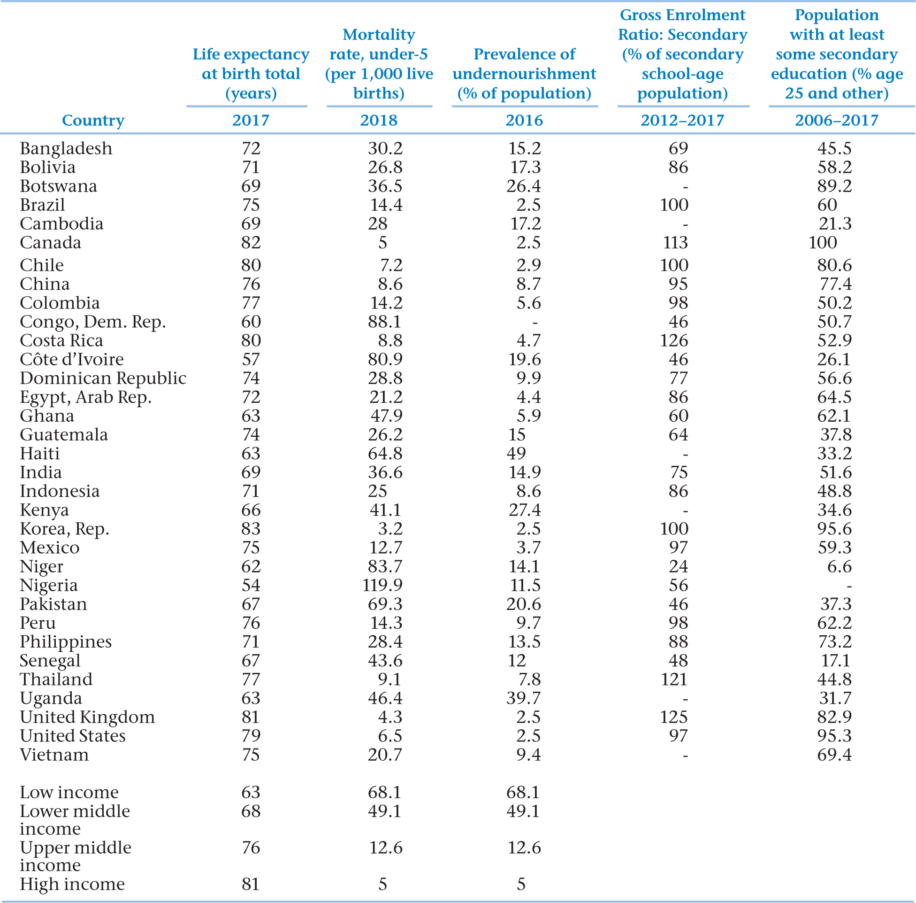
Table 2.3
Commonality and Diversity: Some Basic Indicators of Health and Education
Source for health indicators: WDI. Source for education indicators: UNDP.
Notes:
Thursday: first case study
GDP per capita is not the only way in evaluating development. i.e. Cuba
Cuba has good education, health care, but low wages

Slide 15
2.3 Holistic Measures of Living Levels and Capabilities
Income is one indicator, but needs to be supplement with others
Health e.g. Life Expectancy
Education
The New Human Development Index (NHDI), or simply “HDI”
Introduced by UNDP in November 2010
NHDI as an attempt to create and use holistic measure of living levels; takes into account income, health, and education
NHDI can be calculated for groups and regions in a country
HDI varies among groups within countries
HDI varies across regions in a country
HDI varies between rural and urban areas
Notes:
Developing countries could have many people living in poverty, and might be low in certain categories, i.e. education.
Now we’ll talk more about policies.
Rather than counting each data separately, we use HDI wo calculate development in one country. It is depended on three variables: income, health, and education.

Slide 16
Why is the new New HDI considered an improvement over linear measures such as the Traditional HDI?
Traditional HDI added the three components, divided by 3 (arithmetic mean)
The New HDI takes the cube root of the product of the 3 component indexes
The traditional HDI linear calculation assumed one component traded off against another as perfect substitutes, a strong assumption
The reformulation now allows for imperfect substitutability - widely considered a more plausible way to frame the tradeoffs
Notes:
The original HDI basically has an index on each field evenly, 1/3 on each field, but it is changed in 2010.
One static we have to include in assignment is HDI.

Slide 17
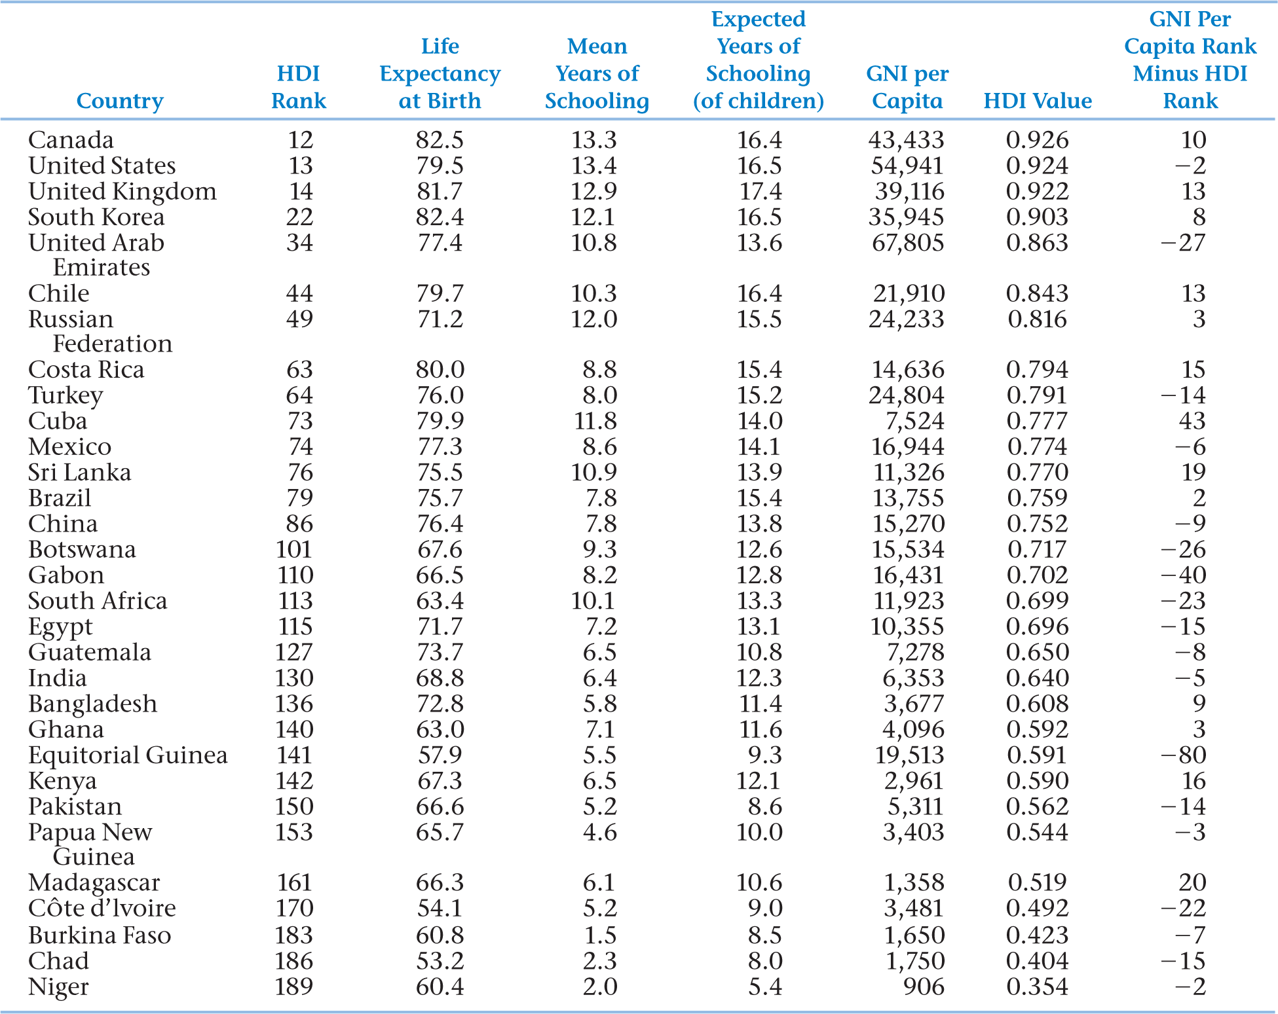
Table 2.4
2018 Human Development Index and its Components for Selected Countries
Source: United Nations Development Program
Notes:
The bigger the number, the better in HDI.

Slide 18
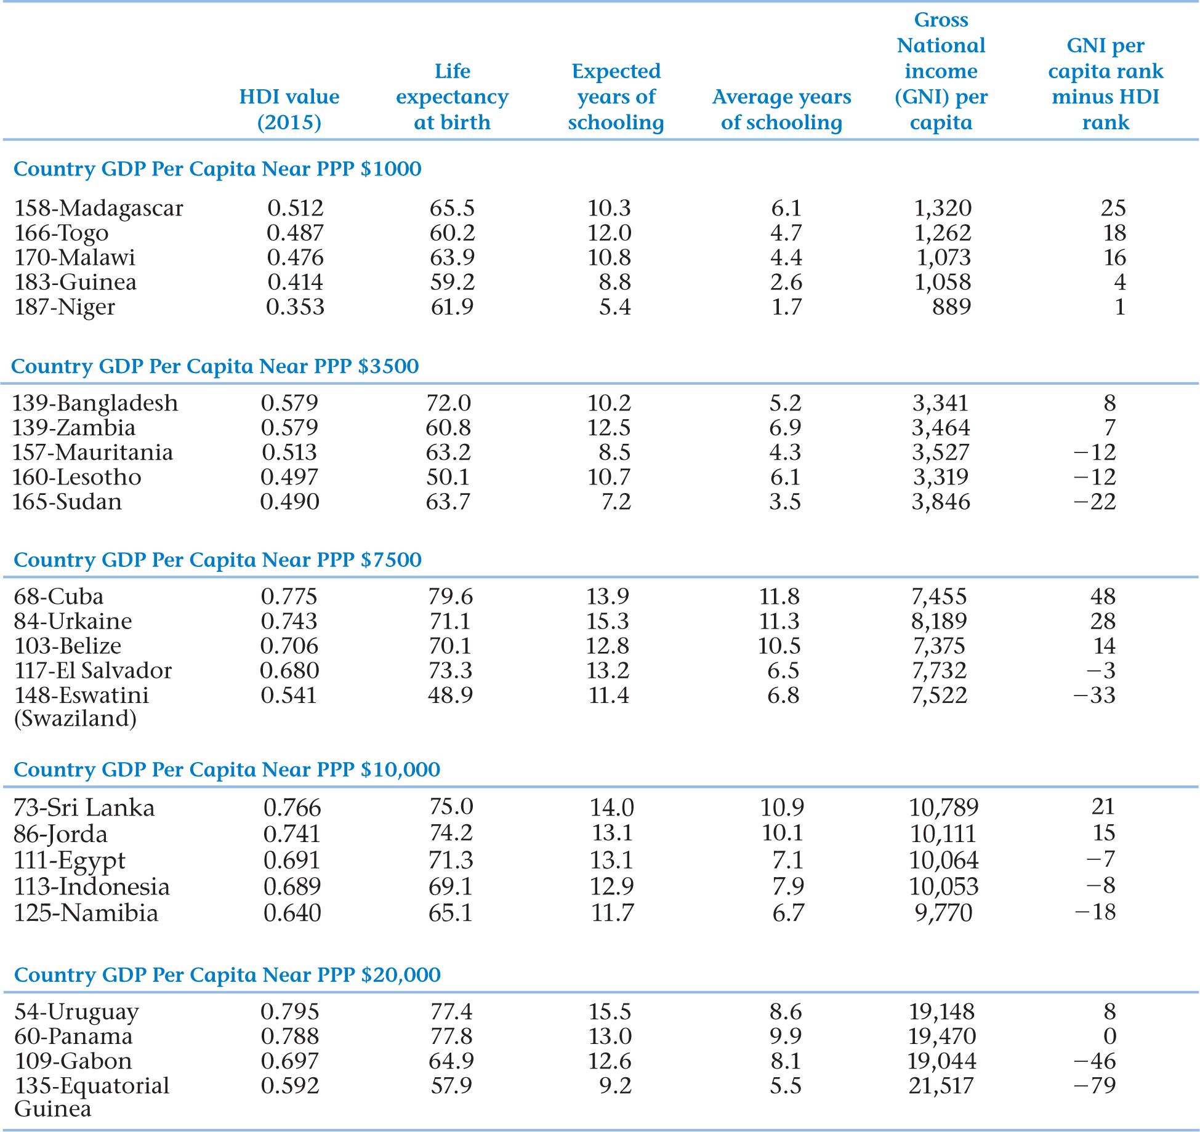
Table 2.5
HDI for Countries with Similar Income Levels
Data Source: 2016 Human Development Report 2016, Table 1, Pages 198-201 (New York: United Nations Development Program), 2015 data.

Slide 19
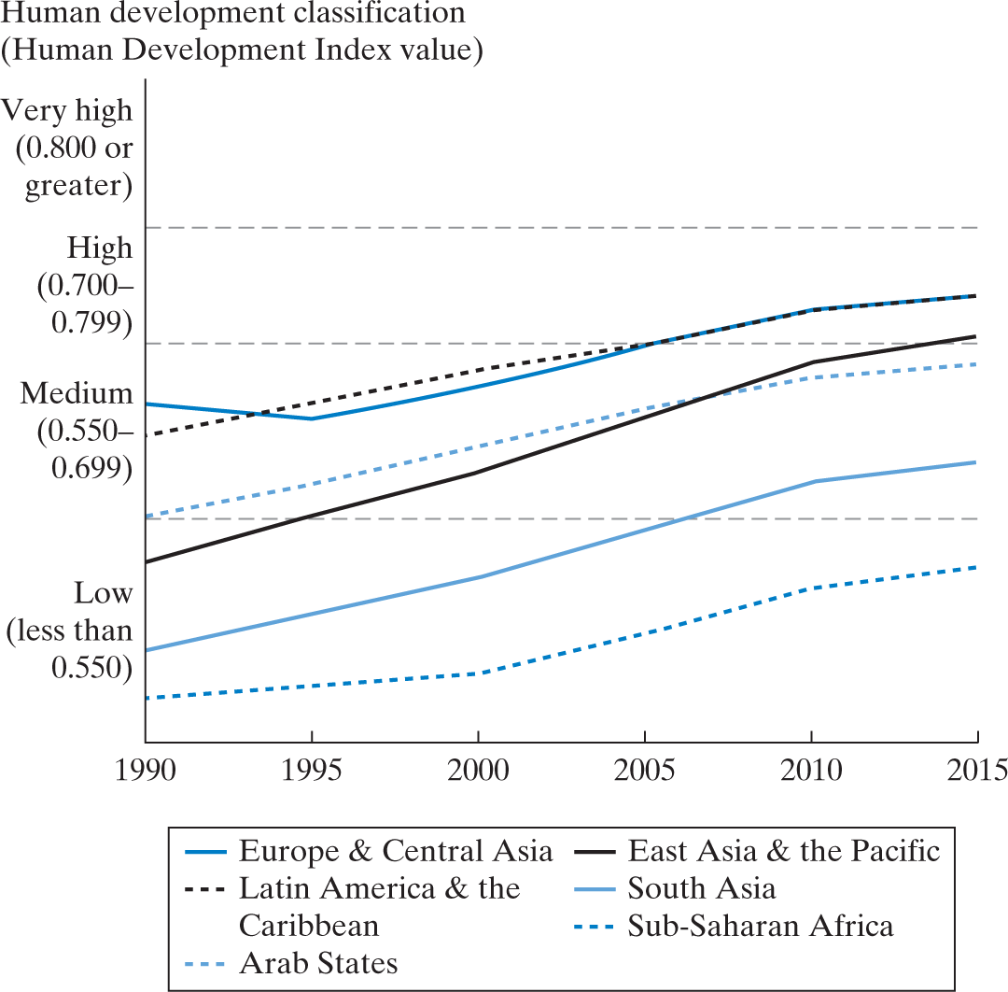
Figure 2.3 Improvements in Human Development Since 1990, by Region
Source: Human Development Report Office, UNDP – Human Development Report, 2016, p. 27

Slide 20
Inequality adjusted HDI
Imposes a penalty on the HDI that increases as inequality increases.

Slide 21
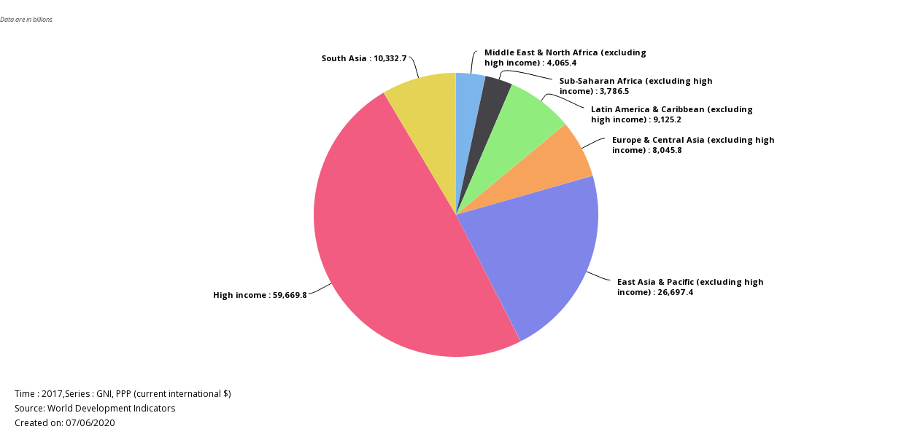
Shares of Global Income

Slide 22
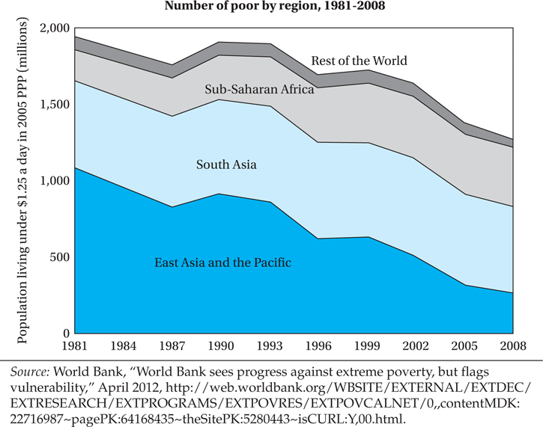
Notes:
Three big countries: China, India, and Brazil
These countries could largely change the statics.

Slide 23
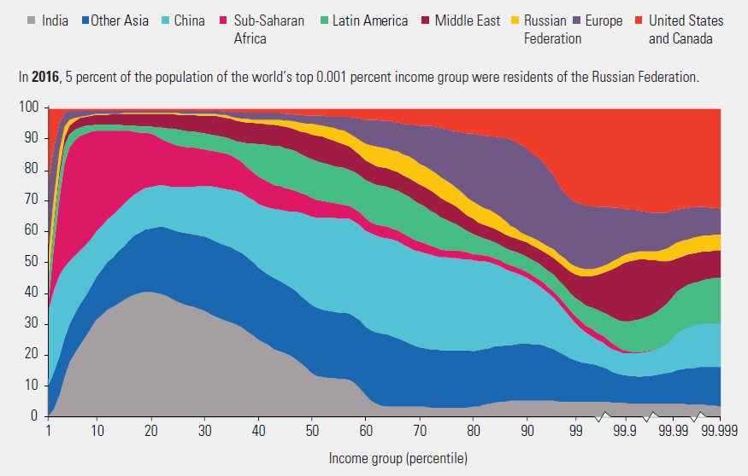
World Income by Percentiles of the Population
Source: Human development report 2019

Slide 24
Sample Iclicker (participation)
To bring the incomes of those living on less that $1.25/day (approximately 1.4 billion people), up to $1.25/day, would require what percentage of the incomes of the world’s wealthiest 10%?
A) 2%
B) 5%
C) 10%
D) 20%

Slide 25
Comparing characteristics among developing countries
Ten points of comparison - both among developing countries, and between developing and developed countries:
Lower levels of living and productivity
Lower levels of human capital
Higher levels of inequality and absolute poverty
Higher population growth rates relative to Developed Countries (not necessarily faster)
Greater social fractionalization
Larger rural population - rapid migration to cities
Lower levels of industrialization and manufactured exports
Adverse geography
Underdeveloped financial and other markets
Colonial Legacies – quality of institutions
Notes:
social fractionalization: religious, ethnics, cultural, ratios that might causes issues.
human capital: number, efficiency
Adverse geography: easy to be damaged by environmental damages.
Financial: not regulated, capital might not be efficient
Colonial Legacies : historical problem

Slide 26
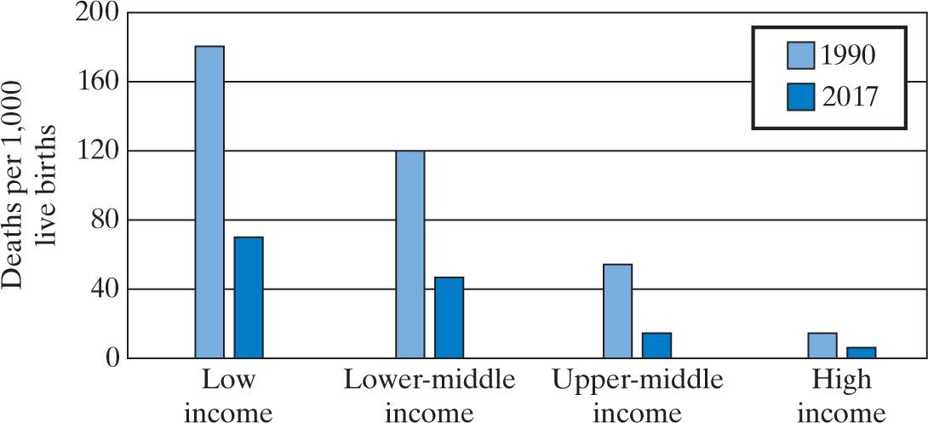
Figure 2.4
Under-5 Mortality Rates, 1990 and 2017
Source: World Development Indicators

Slide 27
2.6 Are Living Standards Converging across Countries?
A Great Divergence followed the Industrial Revolution
Two reasons to think (re-)convergence likely
Diminishing returns to capital (though as economies develop they often find ways to compensate)
Diffusion of ideas across countries, so can skip trial and error and grow fast while catching up
Latter elated to “advantages of backwardness” (Gerschenkron), or “the latecomer’s advantage”
Notes:
Convergence is the gap between rich and poor.
For developed countries, they have equipment while developing countries might not have. With help of equipment, developing countries could gain more with less input. Sharing technology might not able to change this situation, but it could shorten the progress in narrowing the gap.

Slide 28
Convergence?
But - at least until this century - evidence of unconditional national average income convergence has been unconvincing
Continued evidence of divergence between middle and low income countries
There is also evidence of “per capita income convergence,” weighting changes in per capita income by population size
-How? Technology transfer, rapid K-accumulation.
(We consider “conditional” convergence - observed after accounting for other factors - in a general way in context of the Solow neoclassical growth model)
Notes:
Trade could narrow the convergence.

Slide 29
Nature and Role of Economic Institutions
Institutions provide “rules of the game” of economic life
Follows general framework of Nobel Laureate Douglass North

Slide 30
But there is a Lack of:
1) legal system to enforce property rights
2) stable currency
3) infrastructure
4) banking and insurance
5) facilitation of long-term business projects
6) limits to barriers to entry
Also to consider factors like: economies of scale, externalities and poor regulation
WHICH OF THESE DO YOU THINK MIGHT HAVE THE MOST IMPACT?
Notes:
Externalities positive such as sharing tech, negative such as pollution

Slide 31
The Nature and Role of Economic Institutions: Some Caveats and Nuances
Most importantly: Good institutions may both cause development, and improve as a result of development
In addition:
Many institutions are correlated
It is not clear which of these institutions matter most
Unclear how specific in form institutions must be to fulfill their main function
Progress may be made when only some institutions are of high quality; but further progress may require improving quality of additional institutions
The specifics of their relative importance, and the sequence of improving them, may well vary by country

Slide 32
Appendixes: for reference only

Slide 33
*Note on National Income Definitions and Calculations*
The “Atlas” method for computing Gross National Income (GNI) is the sum of value added by all resident producers plus any product taxes (less subsidies) not included in the valuation of output plus net receipts of primary income (compensation of employees and property income) from abroad
Data are in current U.S. dollars converted using the World Bank Atlas method
Gross national income, in purchasing power parity, is GNI converted to international dollars using PPP rates. An international dollar has the same purchasing power over GNI that a U.S. dollar has in the United States.
Gross national income per capita is GNI divided by midyear population.
Gross domestic product is the sum of value added by all resident producers plus any product taxes (less subsidies) not included in the valuation of output.
Growth is calculated from constant price GDP data in local currency.
Gross domestic product per capita is GDP divided by midyear population.
*For further details see “Sources and Methods,” in World Development Indicators (WDI), 2017

Slide 34
Concepts for Review
Absolute poverty
Brain drain
Capital stock
Convergence
Crude birth rate
Dependency burden
Depreciation (of the capital stock)
Diminishing Marginal Utility
Divergence
Economic Institutions
Fractionalization
Free trade
Gross domestic product (GDP)
Gross national income (GNI)
Human capital
Human Development Index (HDI)

Slide 35
Concepts for Review (Continued)
Imperfect market
Incomplete information
Infrastructure
Least developed countries
Low-income countries (LICs)
Middle-income countries
Newly industrializing countries (NICs)
Purchasing power parity (PPP)
Research and development (R&D)
Resource endowment
Terms of trade
Value added
World Bank

